Slide 1
MongoDB Aggregation Like A Champ!
Nuri Halperin | Plus N Consulting, Inc. | © 2016

Slide 2
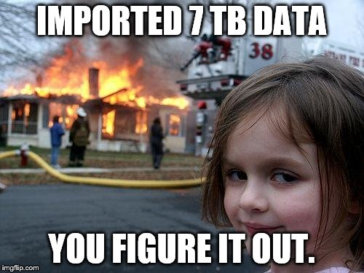

Slide 3
Agenda – Aggregation
Concepts
Key pipeline stages
$match
$group
$project
$unwind
New operators
$lookup
$graphLookup

Slide 4
The Aggregation Framework
find()
aggregate()
Single-Document
Single-Stage
Cross-Document
Pipeline

Slide 5
Pipeline Architecture
Stage 1
Stage 2
Stage 3

Slide 6
Pipeline Architecture
Stage 1
Stage 2
Stage 3
filter
group
sort

Slide 7
Pipeline Architecture
Document
Stage 1
Stage 2
Stage 3
filter
group
sort

Slide 8
> db.people.aggregate( [ {$match: {name: 'bob'}}, {...} ]);
Aggregation syntax
Pipeline described using an array of pipeline stages

Slide 9
Pipeline Cast & Crew

$match
$limit
$skip

$group


$project
$redact
$unwind
$sort

$geoNear
$out
$sample

Slide 10
Pipeline Cast & Crew

$match
$limit
$skip

$group


$project
$redact
$unwind
$sort

$geoNear
$out
$sample

Slide 11
Pipeline Cast & Crew

$match
$limit
$skip

$group


$project
$redact
$unwind
$sort

$geoNear
$out
$sample

Slide 12
Pipeline Cast & Crew

$match
$limit
$skip

$group


$project
$redact
$unwind
$sort

$geoNear
$out
$sample

Slide 13
Pipeline Cast & Crew

$match
$limit
$skip

$group


$project
$redact
$unwind
$sort

$geoNear
$out
$sample

Slide 14

Pipeline Cast & Crew

$match
$limit
$skip


$group
$lookup
$graphLookup


$project
$redact
$unwind
$sort

$geoNear
$out
$sample

Slide 15
Demo Time!

Slide 16
A Graph
PIE
FAR
YUM
TOL
Notes:
var routeData = [
{ _id: 1, departure: 'PIE', arrival: 'YUM' },
{ _id: 2, departure: 'PIE', arrival: 'TOL' },
{ _id: 3, departure: 'FAR', arrival: 'YUM' },
{ _id: 4, departure: 'YUM', arrival: 'TOL' },
{ _id: 5, departure: 'TOL', arrival: 'FAR' },
];
var cityData = [
{ _id: 'PIE', name: 'St. Petersburg', state: 'FL' },
{ _id: 'YUM', name: 'Yuma', state: 'AZ' },
{ _id: 'TOL', name: 'Toledo', state: 'OH' },
{ _id: 'FAR', name: 'Fargo', state: 'ND' },
];
db.routes.drop();
db.routes.insert(routeData);
db.cities.drop();
db.cities.insert(cityData);

Slide 17
Limitations
Memory – killed if exceeds 10% of memory
100 MB mem limit => allowDiskUsage
Predefined operators only (no scripting)
Output options limited

Slide 18


Thank You!
@nurih
in/nurih
Pluralsight Author
Mongo Master
scan me!
Notes:
https://gist.github.com/nurih/f72abbf38fb92927d196

